Slide 1
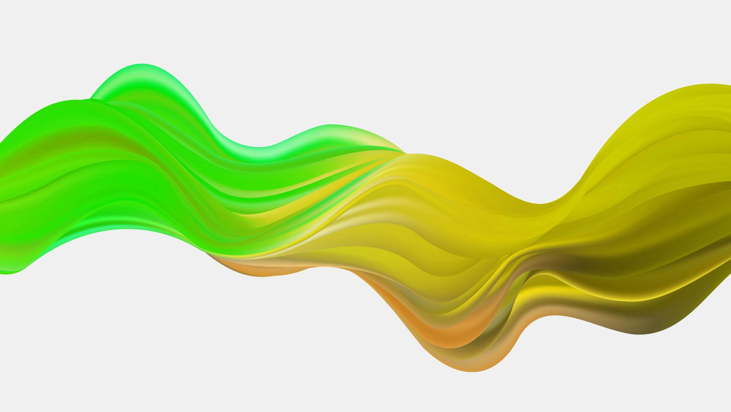
Building CNN
(Convolutional Neural Network)

Slide 2
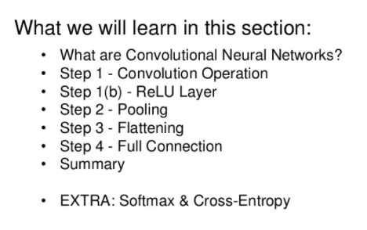
Table of Content

Slide 3

What are Convolutional Neural Networks?

Slide 4


Slide 5
Why we are studying this?
Search applications of CNN.

Slide 6
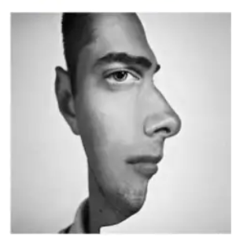
CNN

Slide 7
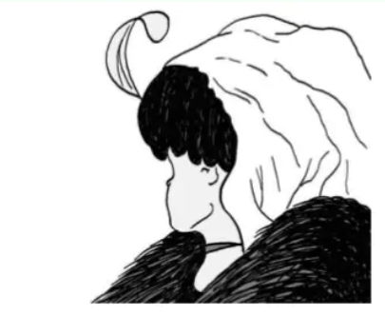
CNN

Slide 8
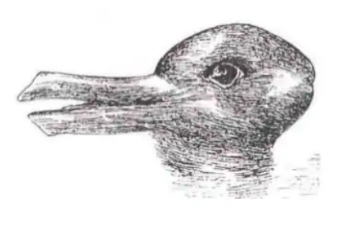
CNN

Slide 9
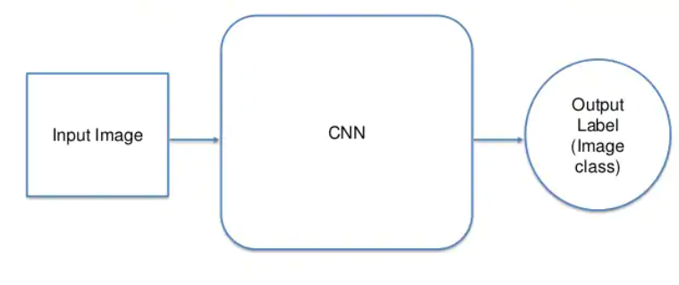
CNN

Slide 10
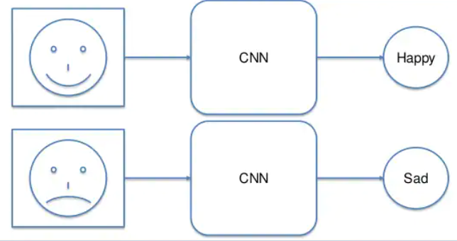
CNN

Slide 11
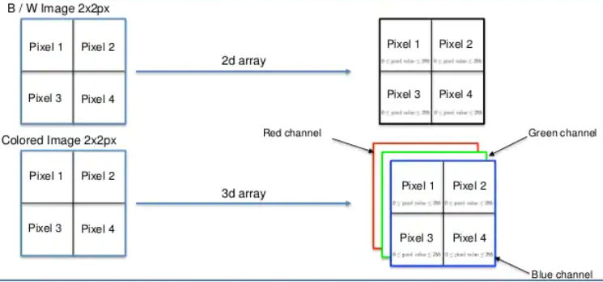
CNN

Slide 12
How CNN is going to help?
The role of the ConvNet is to reduce the images into a form which is easier to process, without losing features which are critical for getting a good prediction.
This is important when we are to design an architecture which is not only good at learning features but also is scalable to massive datasets.

Slide 13
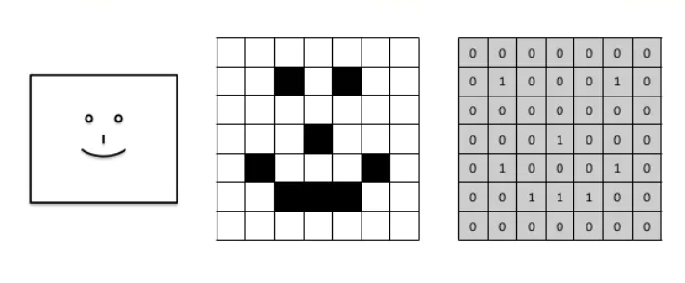

Slide 14
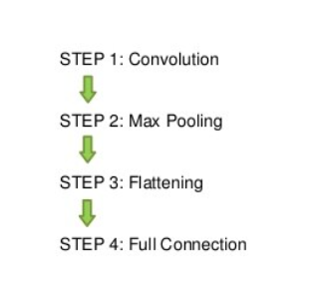
Steps of CNN

Slide 15
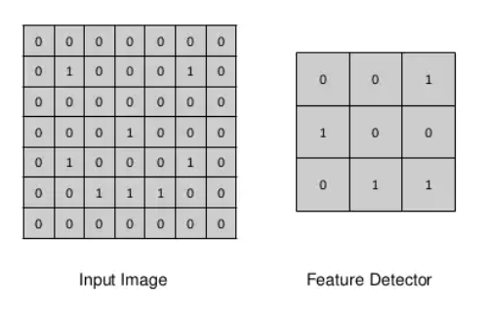
Step 1 Convolution (The Kernel/Filter)

Slide 16
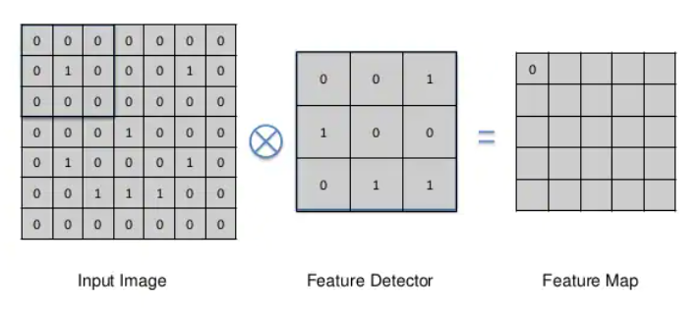
Step 1 Convolution

Slide 17
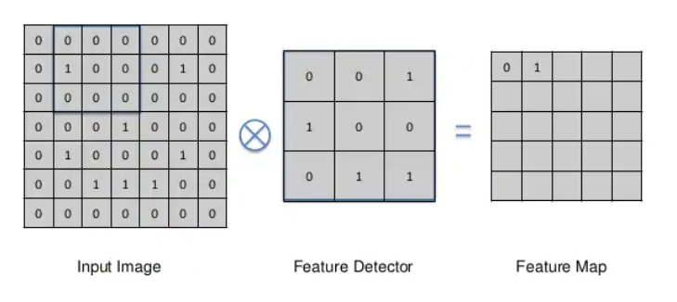

Slide 18
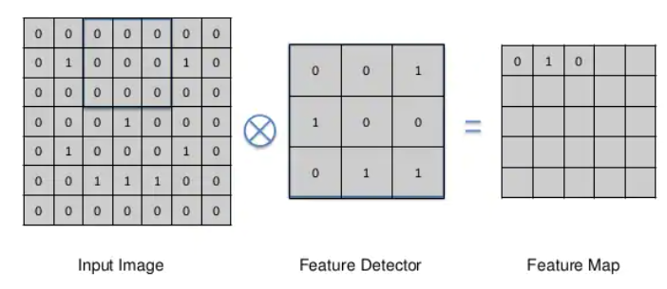

Slide 19
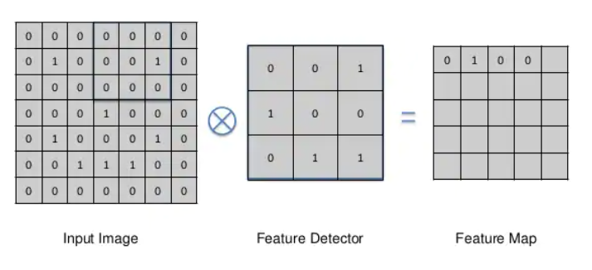

Slide 20
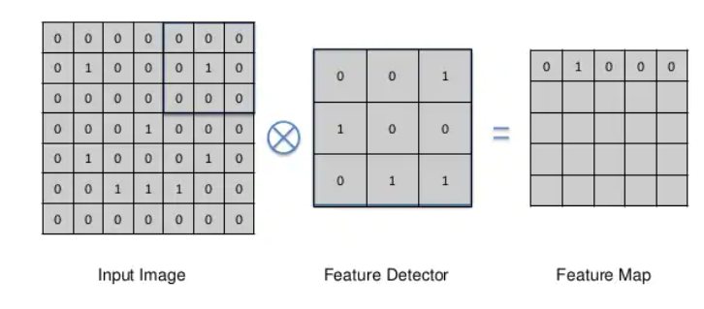

Slide 21
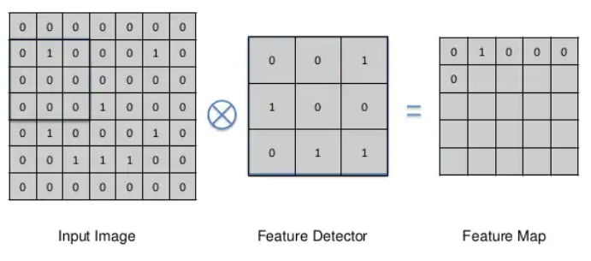
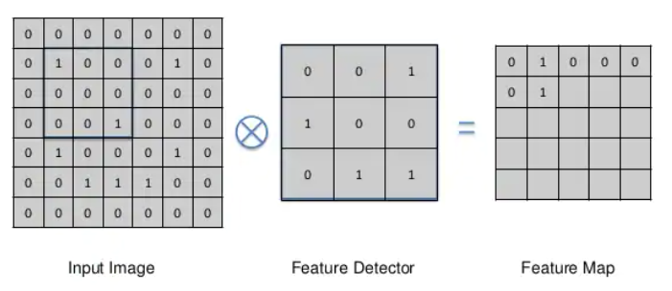

Slide 22
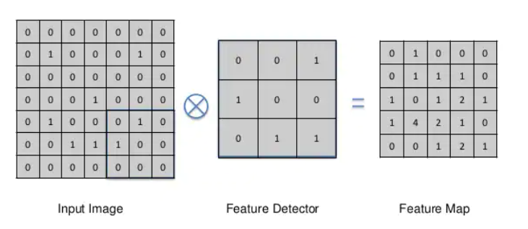
The last step

Slide 23

Another Example
The Kernel shifts 9 times because of Stride Length = 1, every time performing a matrix multiplication operation between K and the portion P of the image over which the kernel is hovering.

Slide 24
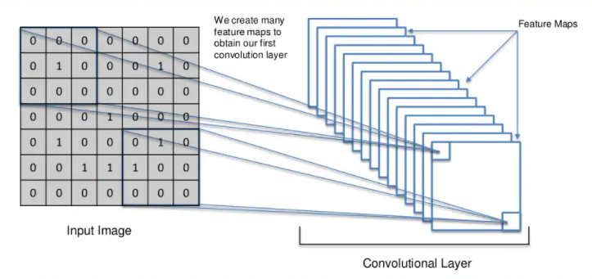

Slide 25

Multiple Channels

Slide 26
Explanation of the previous fig.
The filter moves to the right with a certain Stride Value till it parses the complete width.
Moving on, it hops down to the beginning (left) of the image with the same Stride Value and repeats the process until the entire image is traversed.
In the case of images with multiple channels (e.g. RGB), the Kernel has the same depth as that of the input image. Matrix Multiplication is performed between Kn and In stack ([K1, I1]; [K2, I2]; [K3, I3]) and all the results are summed with the bias to give us a squashed one-depth channel Convoluted Feature Output.

Slide 27

Another Example
With stride length =2

Slide 28
Why we are doing this? (Convolution)
The objective of the Convolution Operation is to extract the high-level features such as edges, from the input image. ConvNets need not be limited to only one Convolutional Layer.
Conventionally, the first ConvLayer is responsible for capturing the Low-Level features such as edges, color, gradient orientation, etc.
With added layers, the architecture adapts to the High-Level features as well, giving us a network which has the wholesome understanding of images in the dataset, similar to how we would.

Slide 29
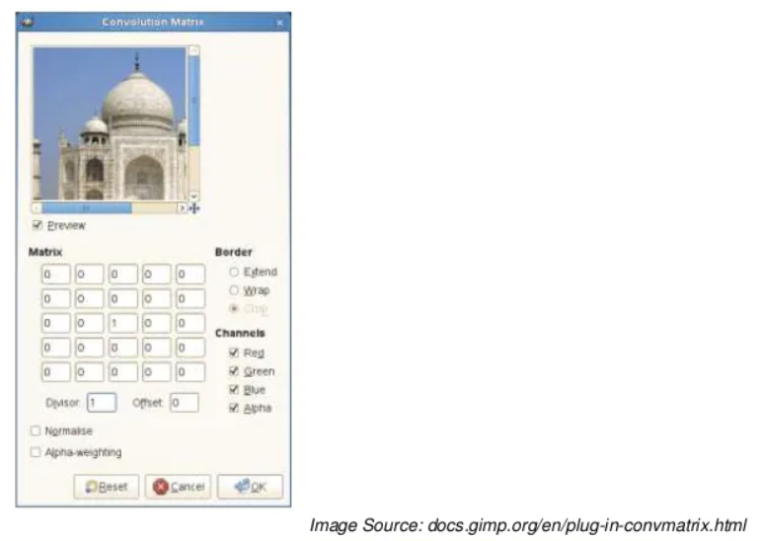
https://docs.gimp.org/2.10/en/gimp-filter-convolution-matrix.html

Slide 30
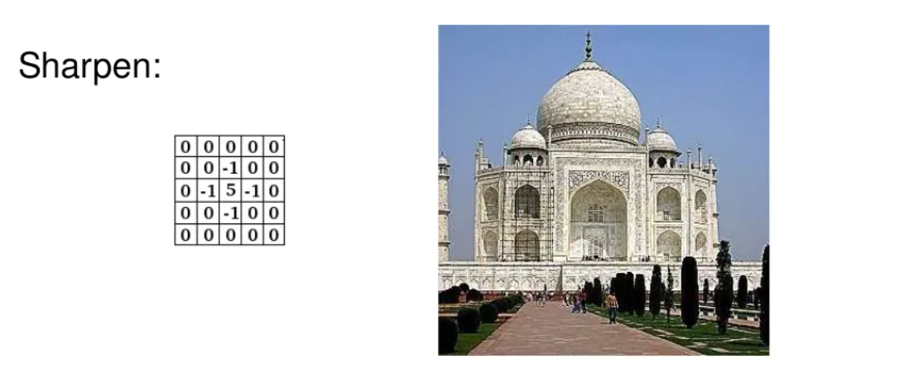

Slide 31
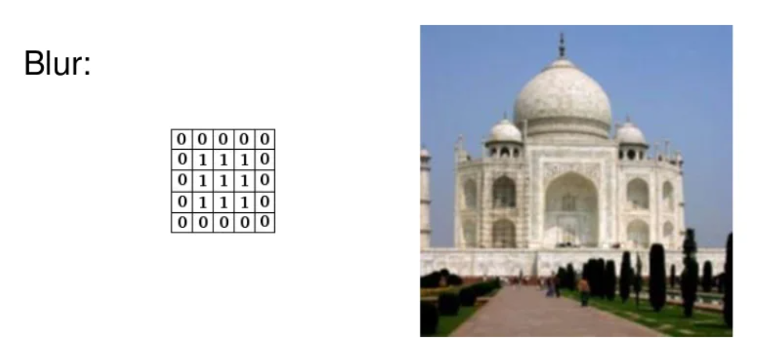

Slide 32
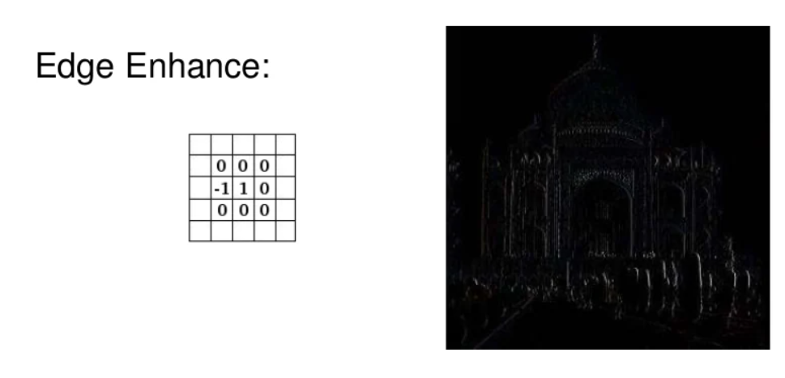

Slide 33
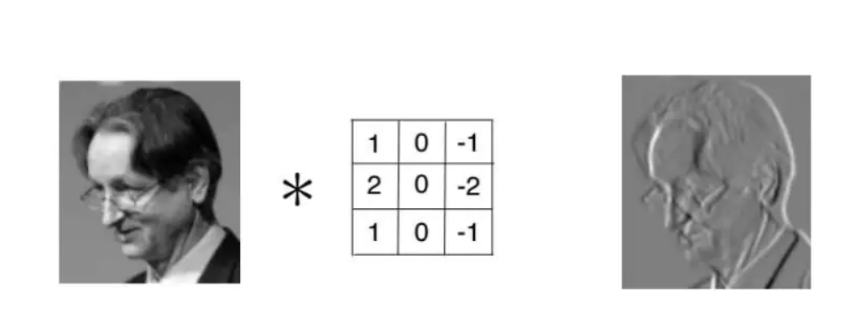

Slide 34
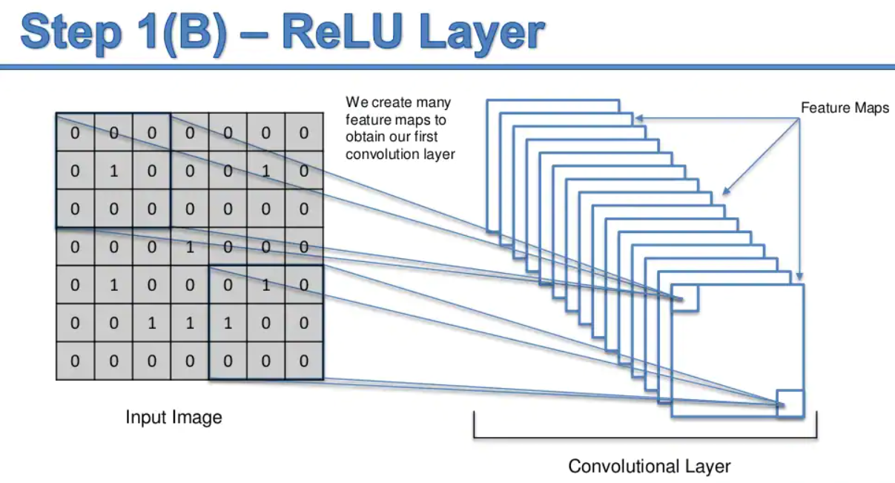

Slide 35
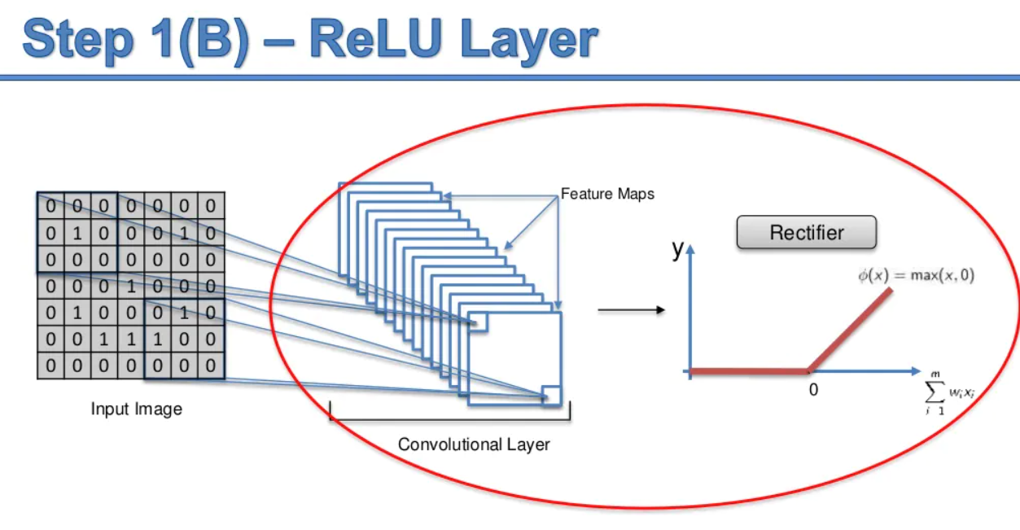

Slide 36
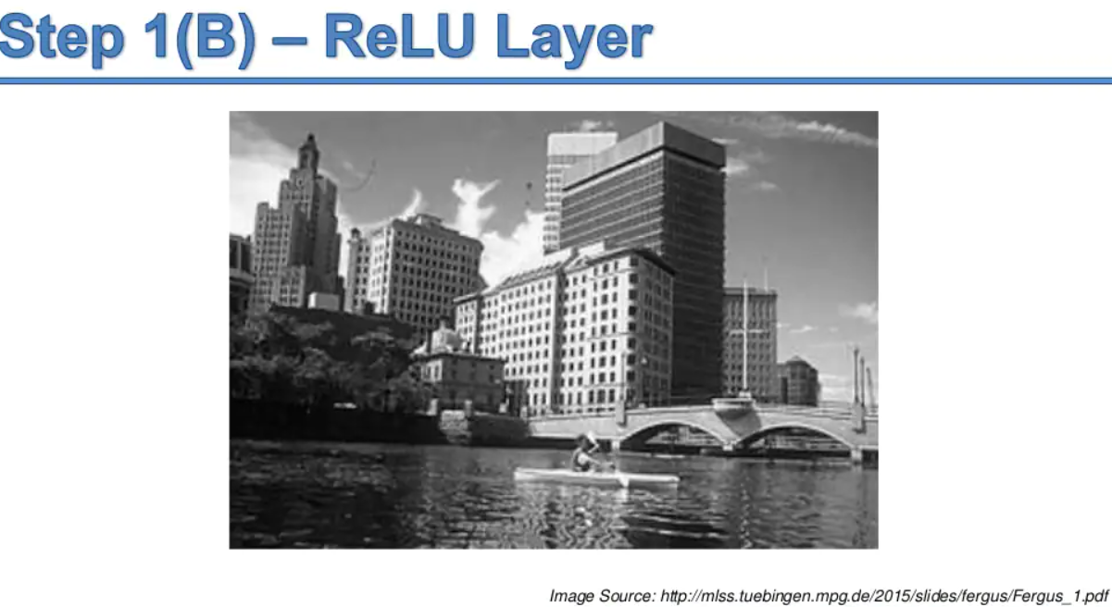

Slide 37
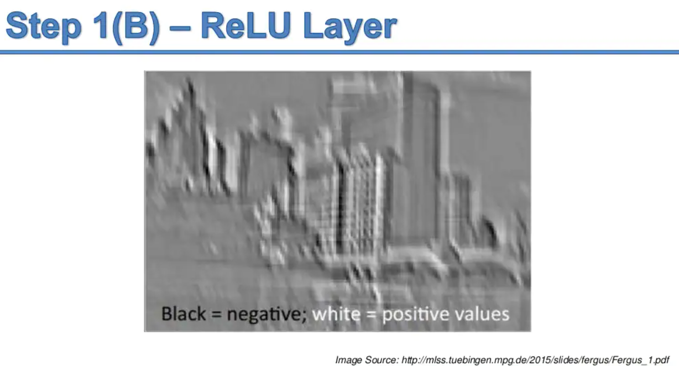

Slide 38
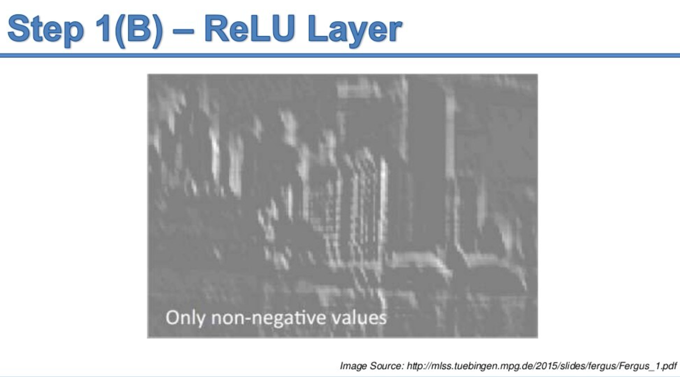

Slide 39
Step 2 Pooling

Slide 40
Pooling
Similar to the Convolutional Layer, the Pooling layer is responsible for reducing the spatial size of the Convolved Feature.
This is to decrease the computational power required to process the data through dimensionality reduction.
Furthermore, it is useful for extracting dominant features which are rotational and positional invariant, thus maintaining the process of effectively training of the model.
There can be different types of pooling: Max pooling, average pooling etc.

Slide 41
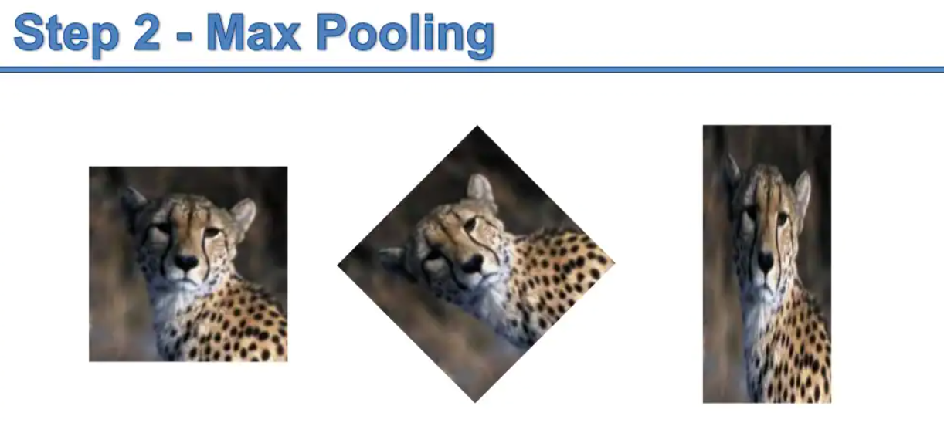

Slide 42
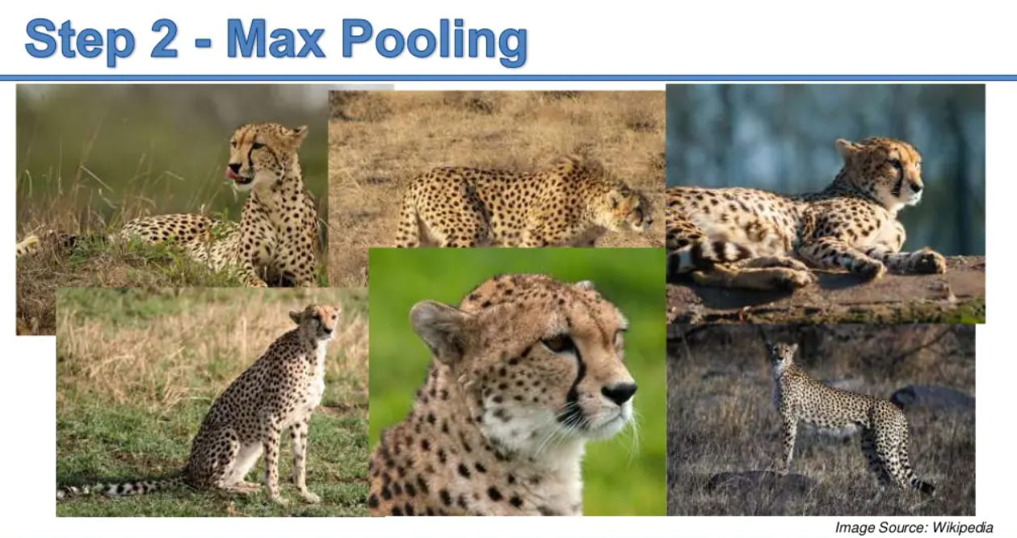

Slide 43

Types of POOLING

Slide 44
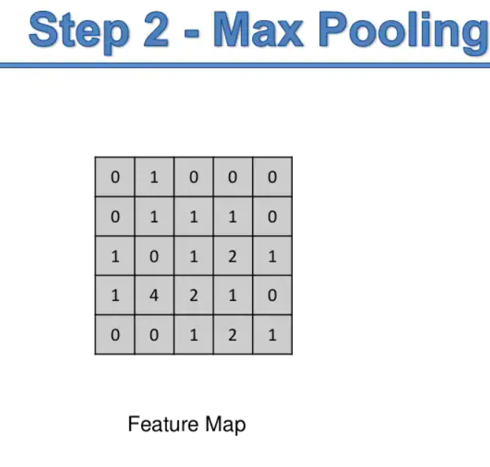

Slide 45
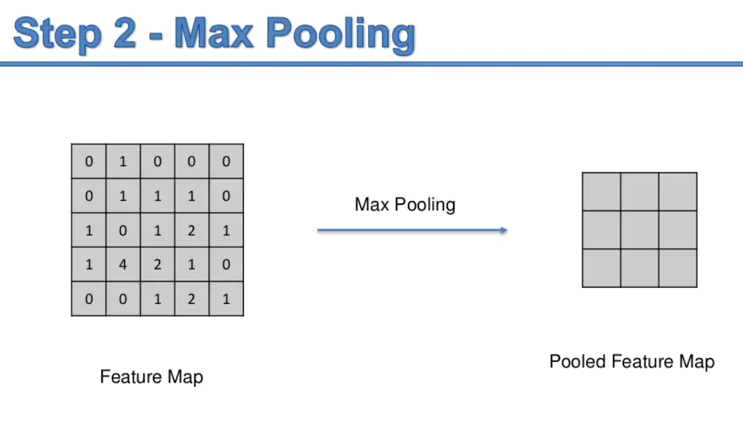

Slide 46
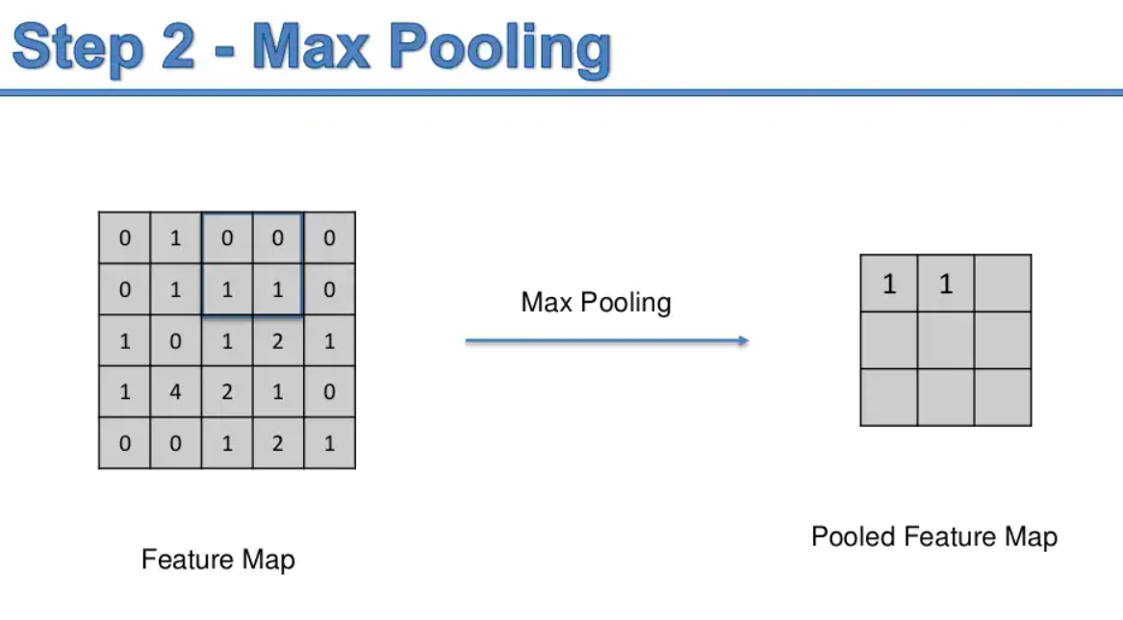

Slide 47
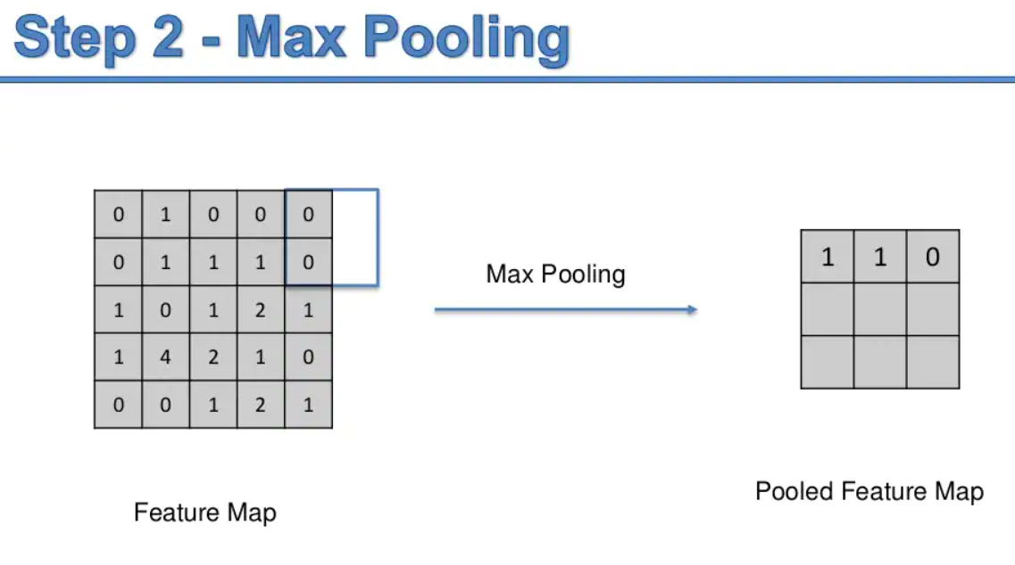

Slide 48
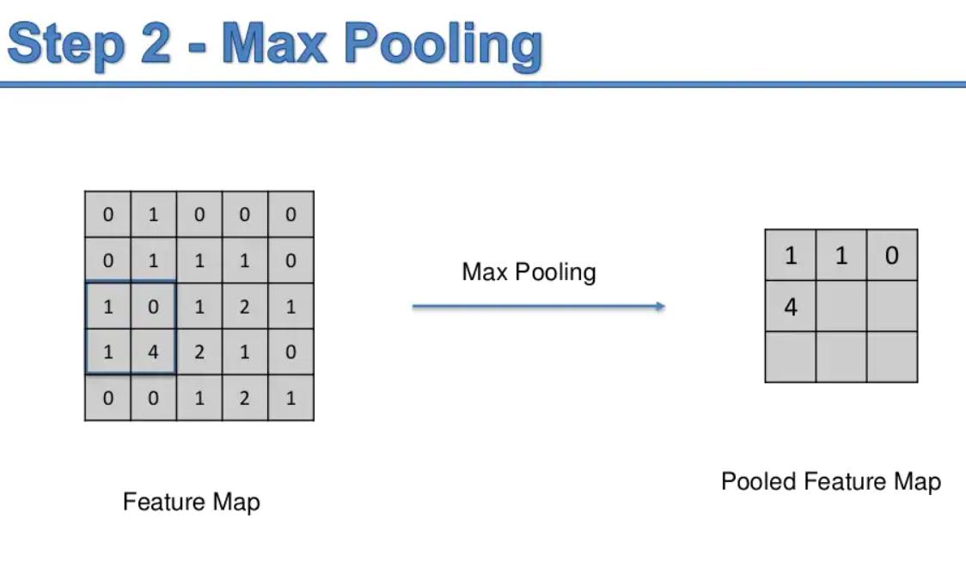
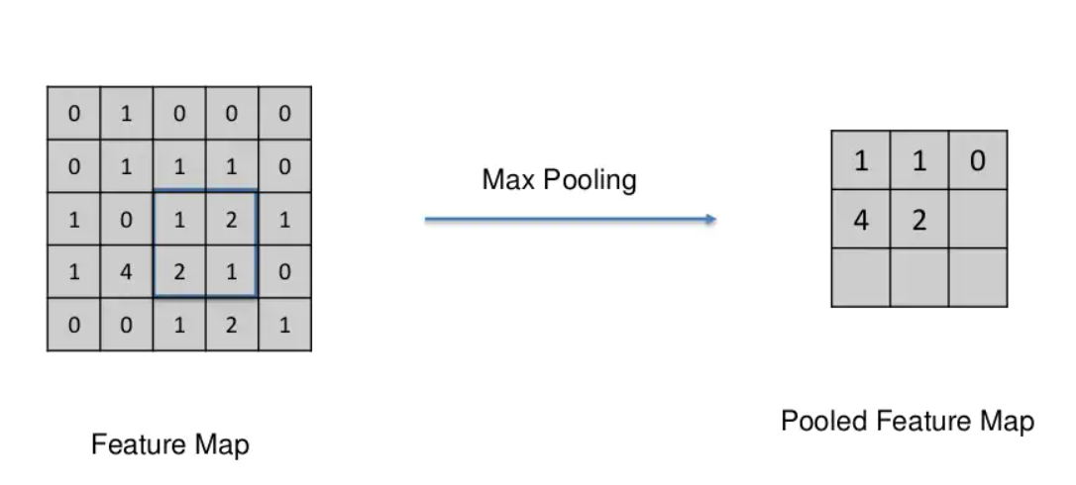

Slide 49
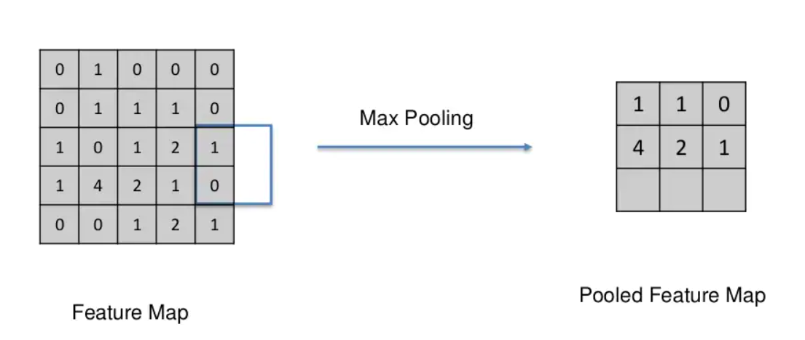
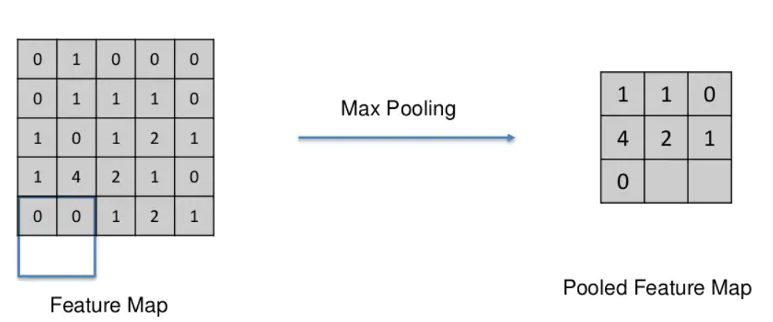

Slide 50
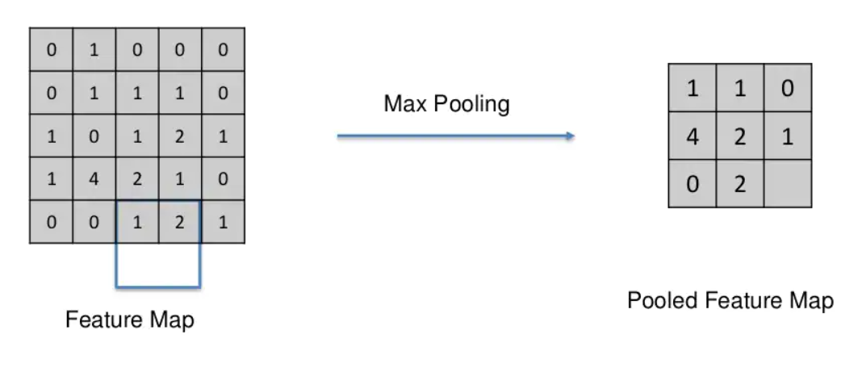
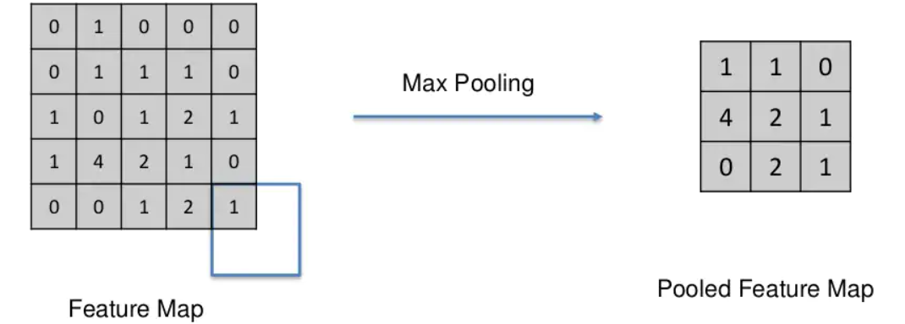

Slide 51
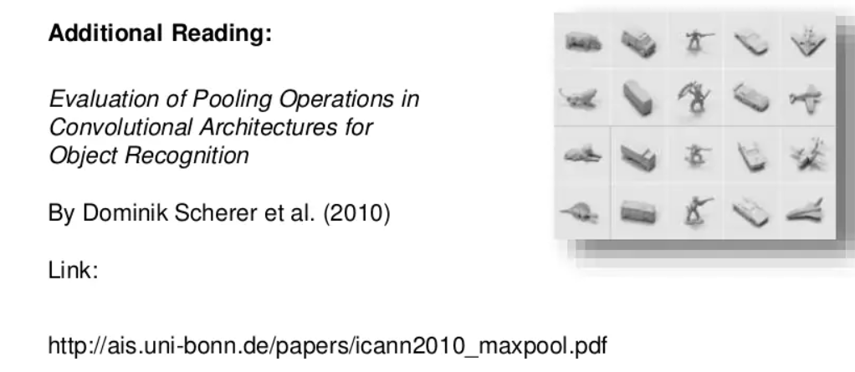
Types of POOLING (optional reading)

Slide 52
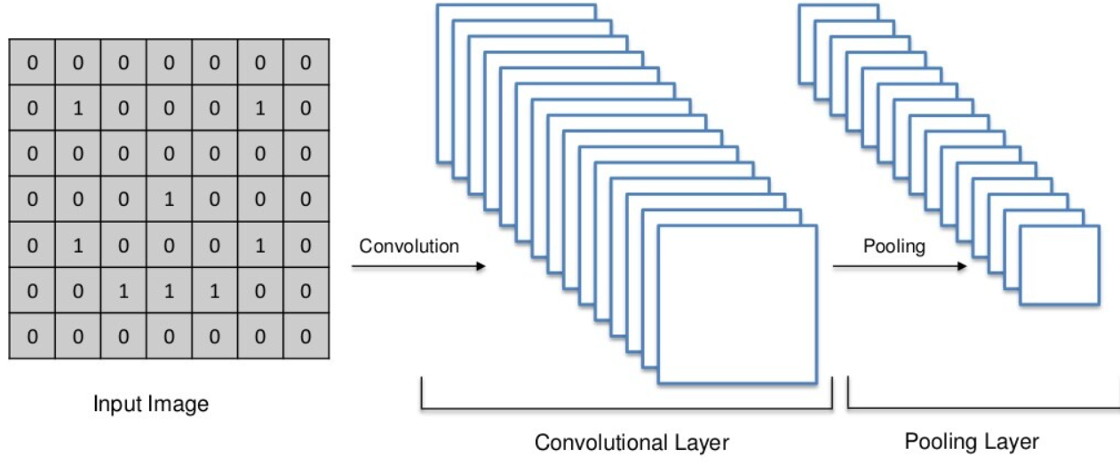
Till now..

Slide 53
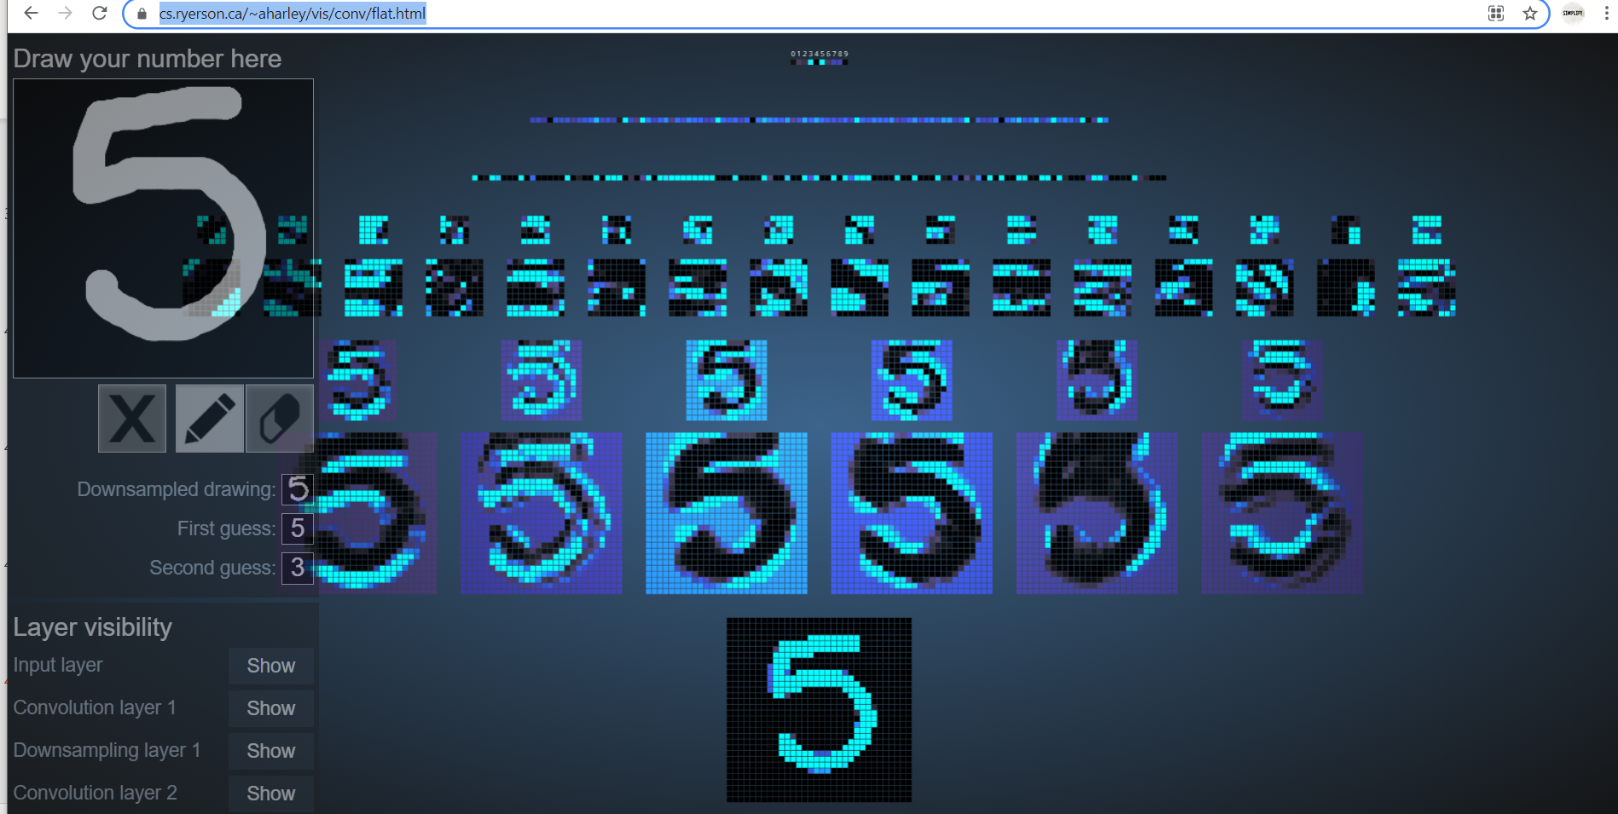
https://www.cs.ryerson.ca/~aharley/vis/conv/flat.html

Slide 54
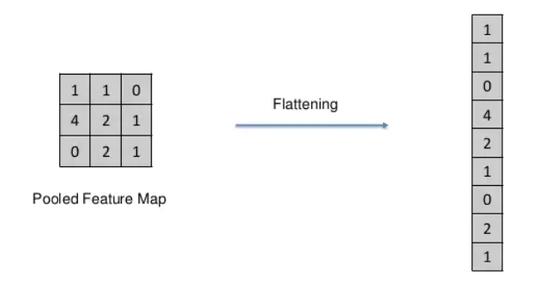
Step 3 Flattening

Slide 55
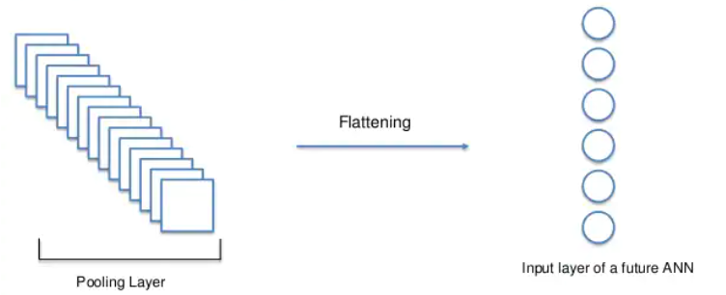

Slide 56
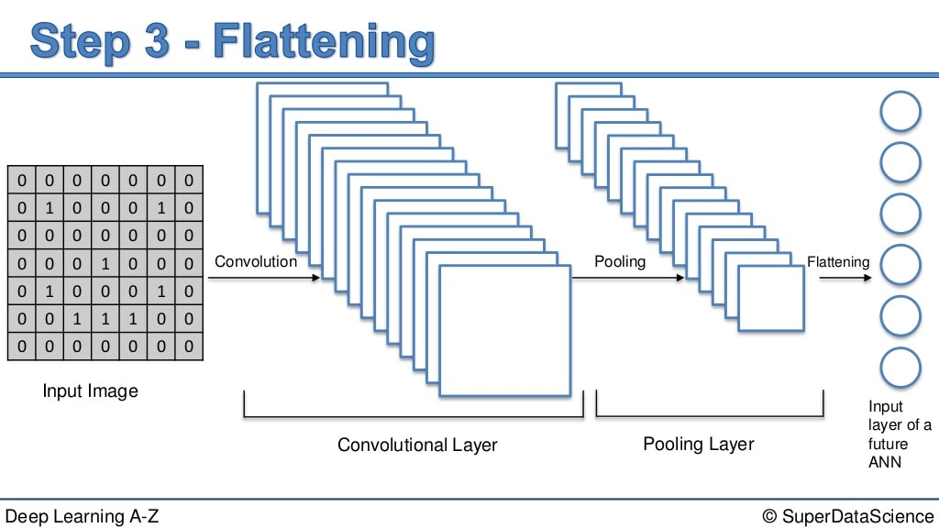

Slide 57
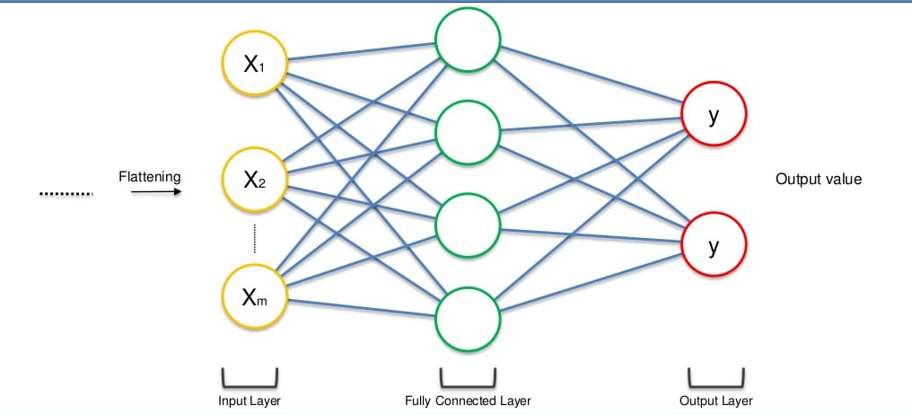
Step 4 Full Connection

Slide 58
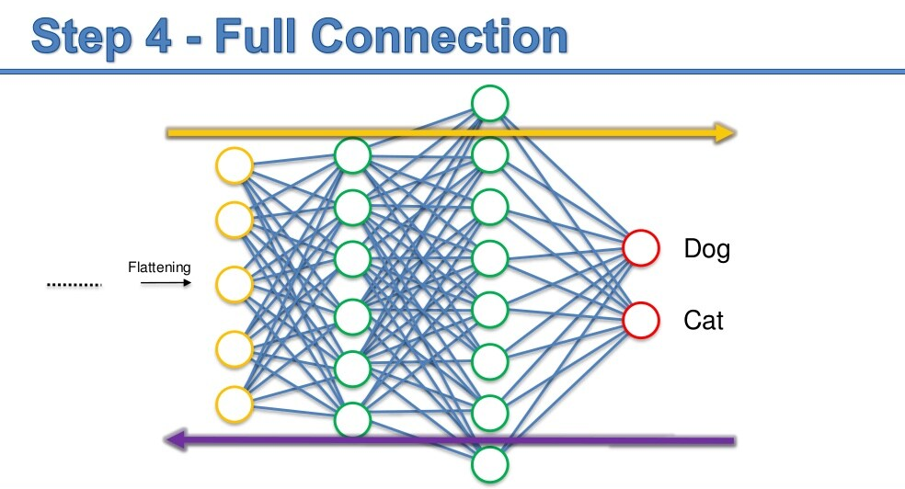

Slide 59


Slide 60


Slide 61


Slide 62


Slide 63


Slide 64

Another example

Slide 65
Reading Task
Read Valid padding and Same padding
https://www.simplilearn.com/tutorials/deep-learning-tutorial/convolutional-neural-network

Slide 66
Must Read
https://towardsdatascience.com/a-comprehensive-guide-to-convolutional-neural-networks-the-eli5-way-3bd2b1164a53
https://www.analyticsvidhya.com/blog/2018/12/guide-convolutional-neural-network-cnn/

